Slide 1
BOXR: Body and head motion Optimization framework for eXtended Reality
Ziliang(Johnson) Zhang, Zexin Li, Hyoseung Kim, Cong Liu
University of California, Riverside
RTSS 2024

Slide 2
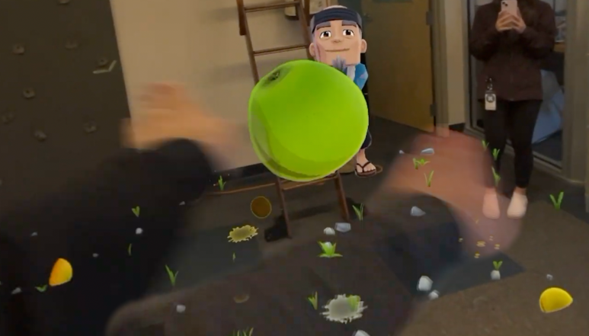
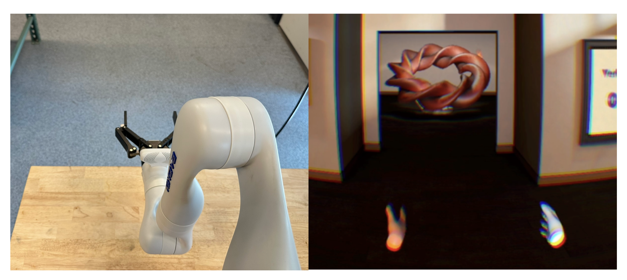
Extended Reality (XR)
Introduction
Background
Challenge
Methodology
Evaluation
What is Extended Reality (XR)?
Creates an immersive virtual-physical user experience
Includes Virtual Reality (VR), Augmented Reality (AR), Mixed Reality (MR)
Why XR is useful?
Intuitive control: user motion directly interact with virtual environment
Diverse use cases: entertainment, teleoperation, accessibility, etc.
*
* iFixit, Vision Pro Teardown: Behind the Complex and Creepy Tech, https://youtu.be/JVJPAYwY8Us

Slide 3
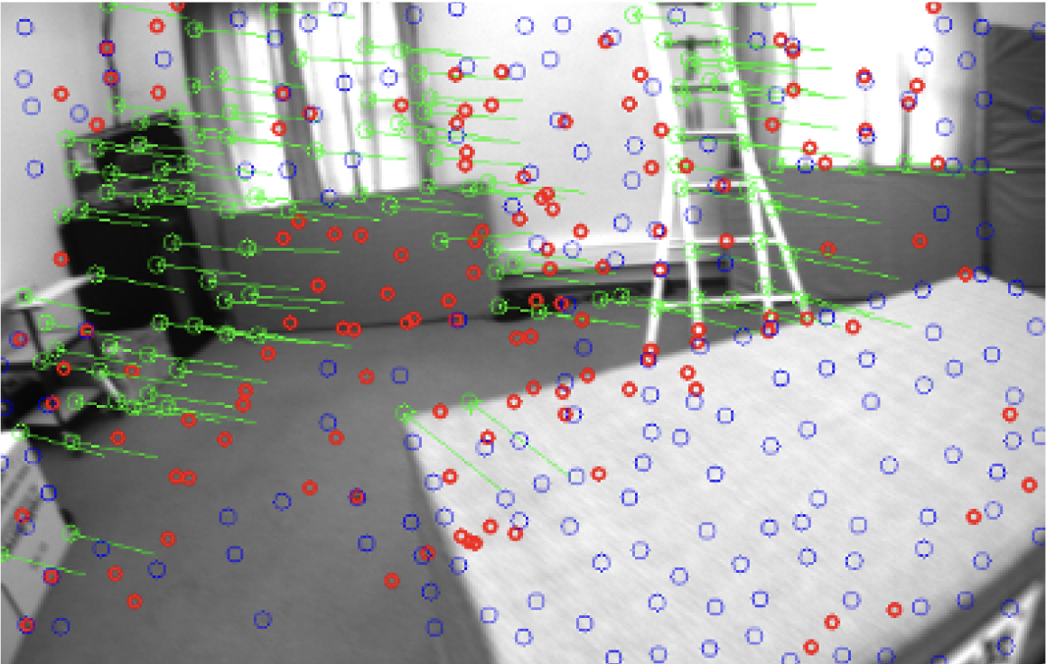
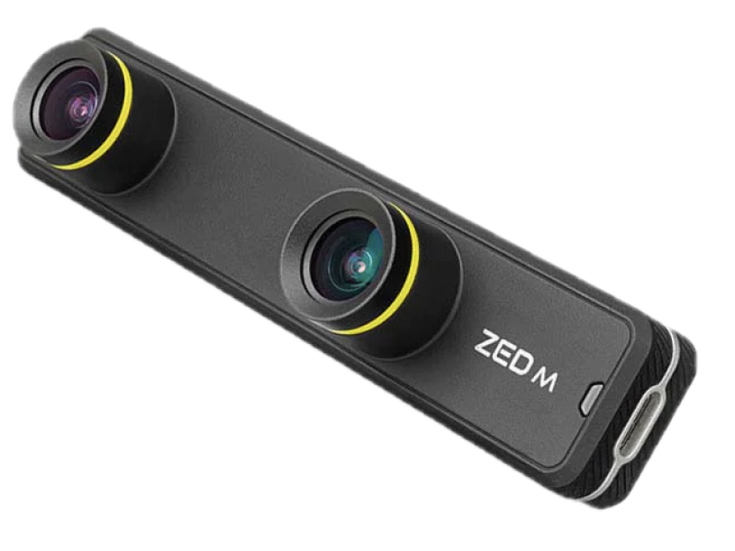
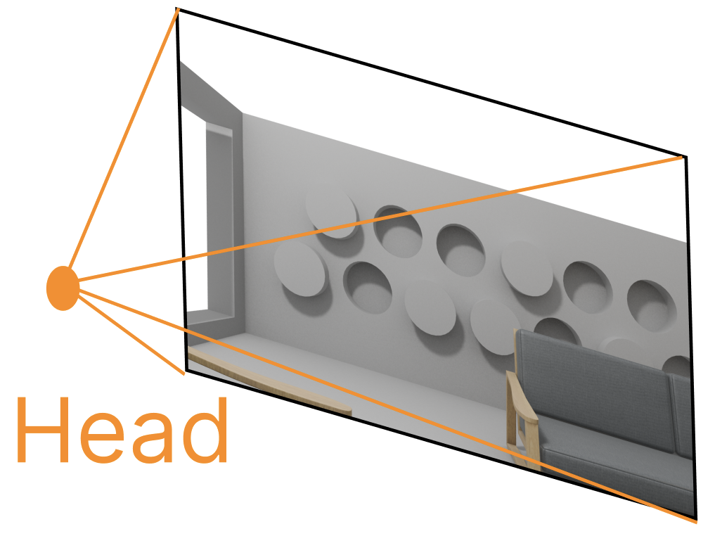
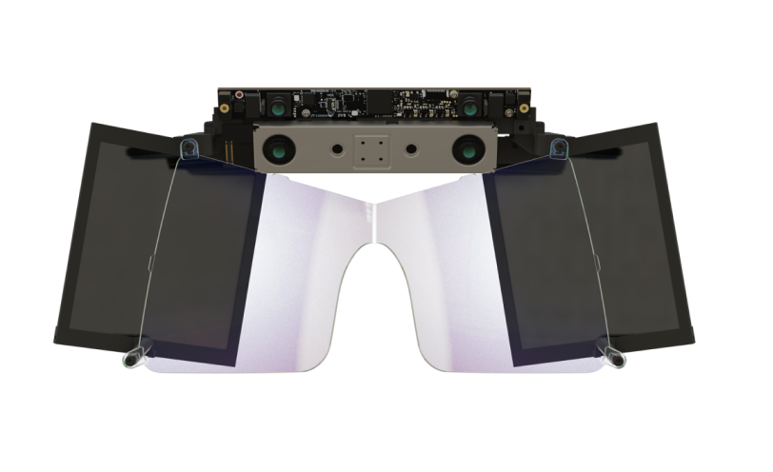
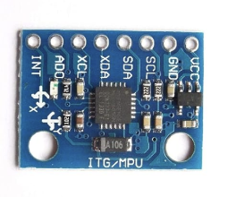
XR pipeline and challenges
Introduction
Background
Challenge
Methodology
Evaluation
How XR systems work?
Head-mount Display (HMD)
User motion
Sensors
Perception Phase
Visualization Phase
Challenges of XR systems
Tight budget for motion display: users can sense motion misalignment in 20ms*
Resource constraints: standalone XR devices use embedded systems with limited computational resources
* Huzaifa, Muhammad, et al. "ILLIXR: Enabling end-to-end extended reality research." 2021 IEEE International Symposium on Workload Characterization (IISWC), 2021.

Slide 4
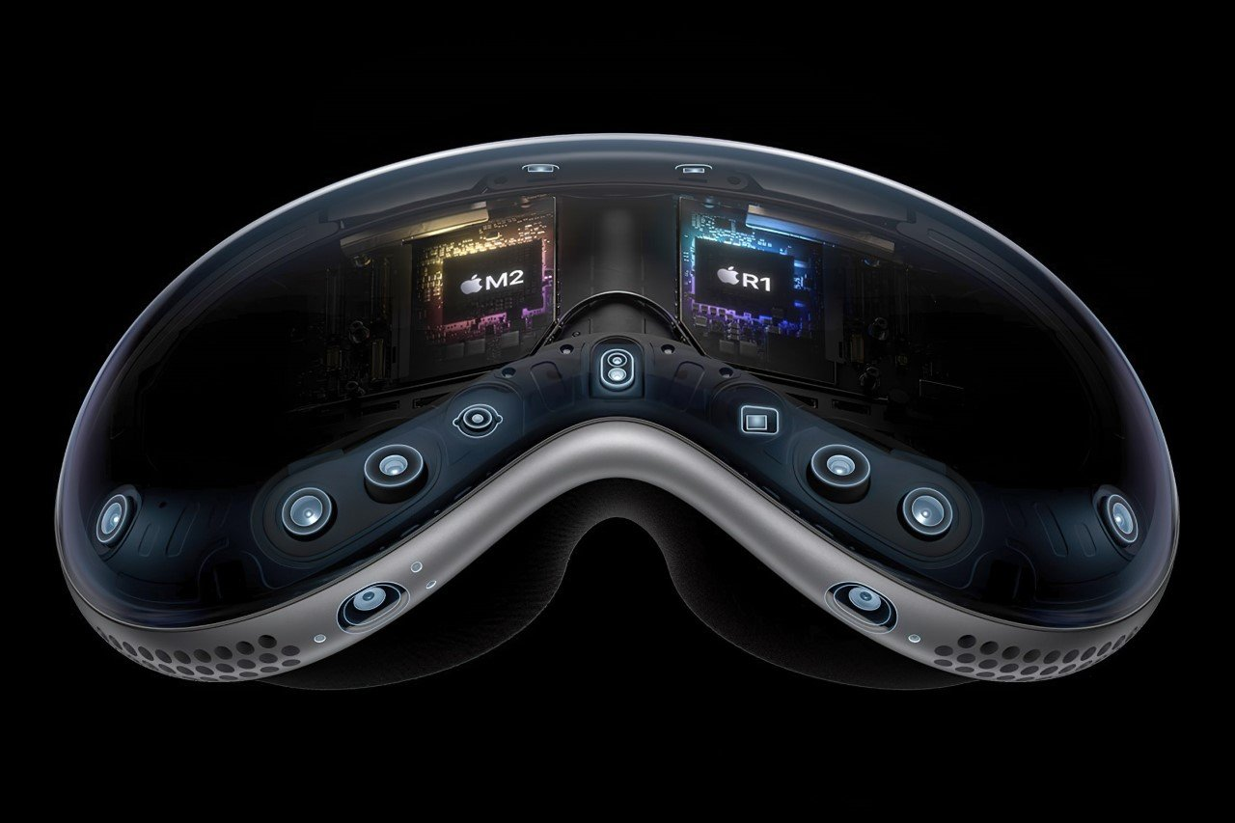
XR Sensors
Introduction
Background
Challenge
Methodology
Evaluation
Inertial Measurement Unit (IMU):
Sample Rate: 500Hz ~ 1000Hz
Data: acceleration and rotation
Stereo Camera (CAM):
Sample Rate: 20Hz ~ 60Hz
Data: a picture of surrounding information (With depth information)
Apple Vision Pro sensors*
* Sarang Sheth, "Every Single Sensor inside the Apple Vision Pro and What It’s Individually Designed To Do." https://www.yankodesign.com/2023/06/07/every-single-sensor-in-the-apple-vision-pro-and-what-its-individually-designed-to-do/

Slide 5
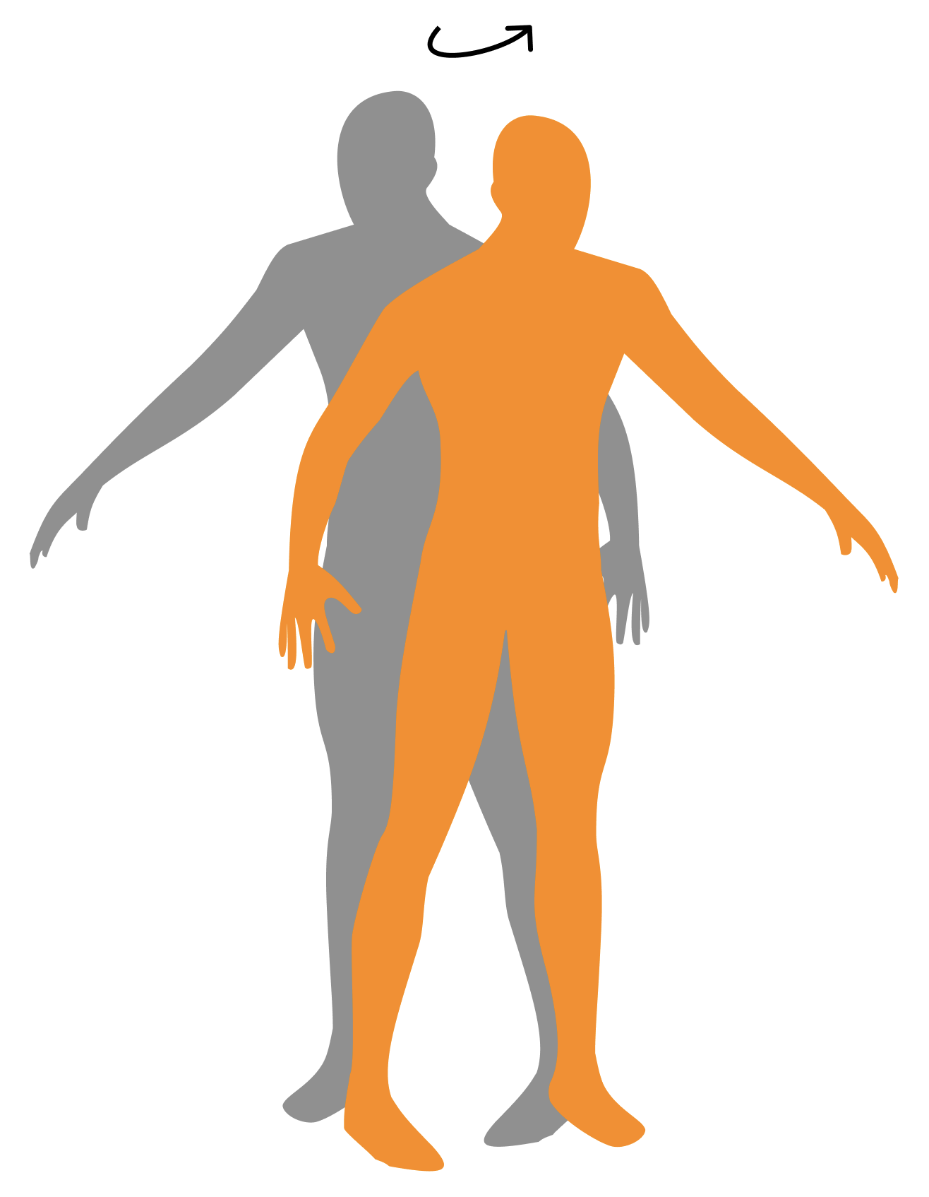
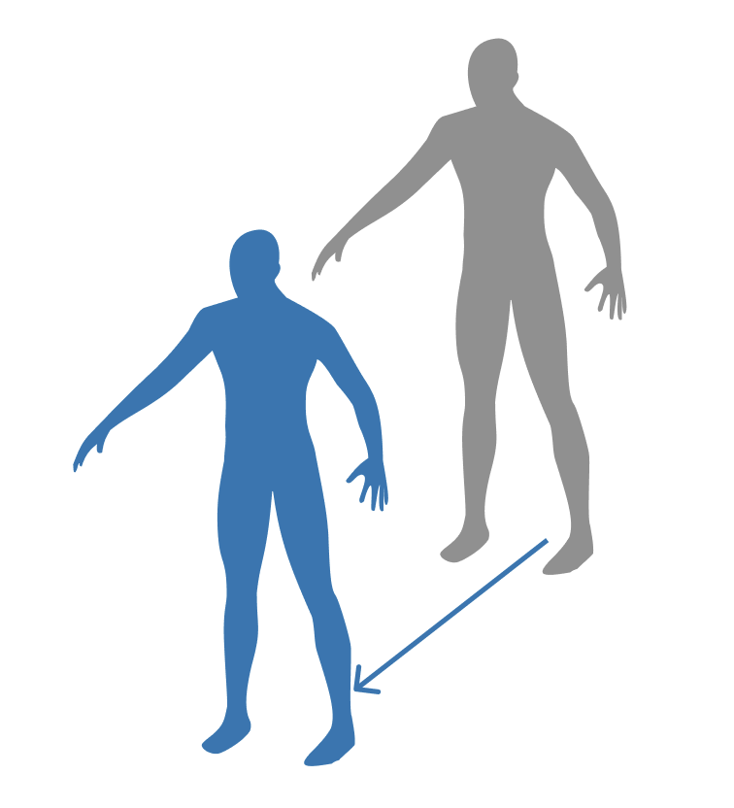
User Motion
Introduction
Background
Challenge
Methodology
Evaluation
Head Motion
Frequent rotational or small-magnitude translational movements
i.e., head shaking, torso rotation, body leaning
Can be accurately captured by IMU
Body Motion
Less frequent but with absolute position change in the environment
i.e., running, walking, skiing, acceleration in car
Requires CAM to perform accurate localization
Notes:
Head: Any motion without changing your position rapidly

Slide 6
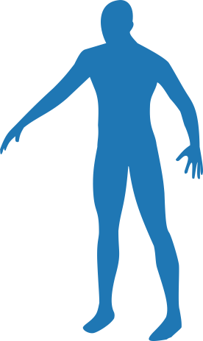
State-of-the-art XR System Model: ILLIXR*
VIO | Visual Inertial Odometer
IMUi | IMU Integration
SR & SRR | Scene Reconstruction (& Rendering)
ATW & ATWR | Asynchronous Timewarp (& Rendering)
Introduction
Background
Challenge
Methodology
Evaluation
Adopts a publisher-subscriber model
Tasks: Visual Inertial Odometer (VIO), IMU integration (IMUi), Scene Reconstruction (SR & SRR), Asynchronous Timewarp (ATW & ATWR)
Image
Raw
Pose
Fused
Pose
Inertia
Frame
Body
timer: 50ms
event: CAM
timer: 8ms
event: SR
CAM
VIO
SR
SRR
timer: 8ms
IMU
IMUi
ATW
ATWR
HMD
Head
timer: 2ms
event: IMU
timer: 8ms
event: ATW
Motion
Sensors
Perception
Visualization
Display
* Huzaifa, Muhammad, et al. "ILLIXR: Enabling end-to-end extended reality research." 2021 IEEE International Symposium on Workload Characterization (IISWC), 2021.
Notes:
Visual Inertial Odometer (VIO):
Subscribes: image and inertia
Triggered: CAM
Extracts features and estimate pose
Publishes: raw pose with body motion information
IMU integration (IMUi):
Subscribes: inertia
Triggered: IMU
Extrapolates the last pose from VIO with latest inertia from IMU
Publishes: fused pose with faster head and slower body motion
Scene Reconstruction (SR) + SR Rendering (SRR)
Subscribes: fused pose
Triggered: every 8ms
Calculates viewport and renders 2D frame
Publishes: 2D Frame (Frame)
Asynchronous Timewarp (ATW) + ATW Rendering (ATWR)
Subscribes: 2D Frame (Frame), fused pose
Triggered: every 8ms
Leverages the latest fused pose (after SRR) to generate user’s view and reprojects the 2D frame
Publishes: 3D Frame (Frame)

Slide 7
Existing metric: Motion-to-Display latency (M2D)
Introduction
Background
Challenge
Methodology
Evaluation
Time between the latest motion by the IMU and its corresponding display on HMD
Why use M2D? Most cases users just sit or stand idle without body motion
Image
Raw
Pose
Fused
Pose
Inertia
Frame
Body
timer: 50ms
event: CAM
timer: 8ms
event: SR
CAM
VIO
SR
SRR
timer: 8ms
IMU
IMUi
ATW
ATWR
HMD
Head
timer: 2ms
event: IMU
timer: 8ms
event: ATW
Motion
Sensors
Perception
Visualization
Display
Notes:
Visual Inertial Odometer (VIO):
Subscribes: image and inertia
Triggered: CAM
Extracts features and estimate pose
Publishes: raw pose with body motion information
IMU integration (IMUi):
Subscribes: inertia
Triggered: IMU
Extrapolates the last pose from VIO with latest inertia from IMU
Publishes: fused pose with faster head and slower body motion
Scene Reconstruction (SR) + SR Rendering (SRR)
Subscribes: fused pose
Triggered: every 8ms
Calculates viewport and renders 2D frame
Publishes: 2D Frame (Frame)
Asynchronous Timewarp (ATW) + ATW Rendering (ATWR)
Subscribes: 2D Frame (Frame), fused pose
Triggered: every 8ms
Leverages the latest fused pose (after SRR) to generate user’s view and reprojects the 2D frame
Publishes: 3D Frame (Frame)

Slide 8
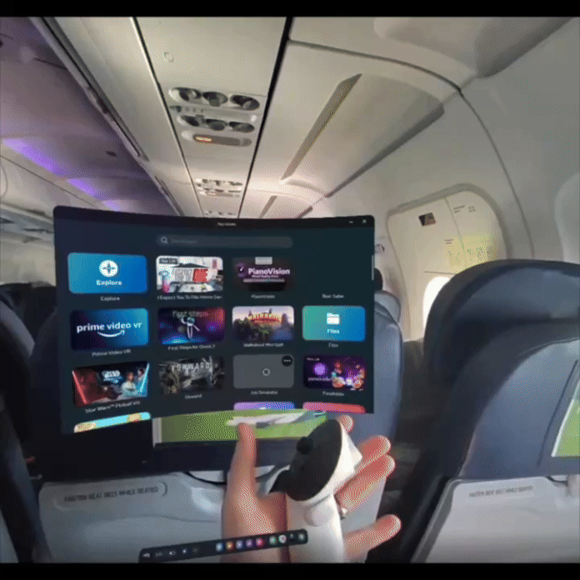
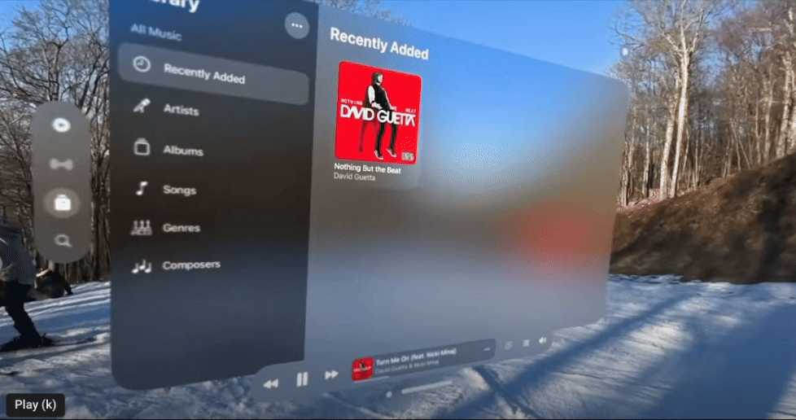
What if we only optimize M2D?
Introduction
Background
Challenge
Methodology
Evaluation
Existing work achieves less than 20ms M2D, but when large body motion involved…
Only head motion is accounted for in M2D
Body motion is NOT considered in M2D metric and thus not optimized
Meta Quest 3 Taking Flight*
Apple Vision Pro Mountain Skiing**
UI is supposed to move along with the user, but it drifts towards to edge of view!
* HistoricBeans, "Quest 3 in flight (passenger video)." https://www.reddit.com/r/OculusQuest/comments/17a8ctd/quest_3_in_flight_passenger_video/
** E. Cosner, "Snowboarding with apple vision pro - can this actually work? " https://youtu.be/LTVuGsYY2yc.

Slide 9
Introducing: Camera-to-Display latency (C2D)
Introduction
Background
Challenge
Methodology
Evaluation
Time between the latest body motion by CAM and its corresponding display on HMD
Image
Raw
Pose
Fused
Pose
Inertia
Frame
Body
timer: 50ms
event: CAM
timer: 8ms
event: SR
CAM
VIO
SR
SRR
timer: 8ms
IMU
IMUi
ATW
ATWR
HMD
Head
timer: 2ms
event: IMU
timer: 8ms
event: ATW
Motion
Sensors
Perception
Visualization
Display

Slide 10
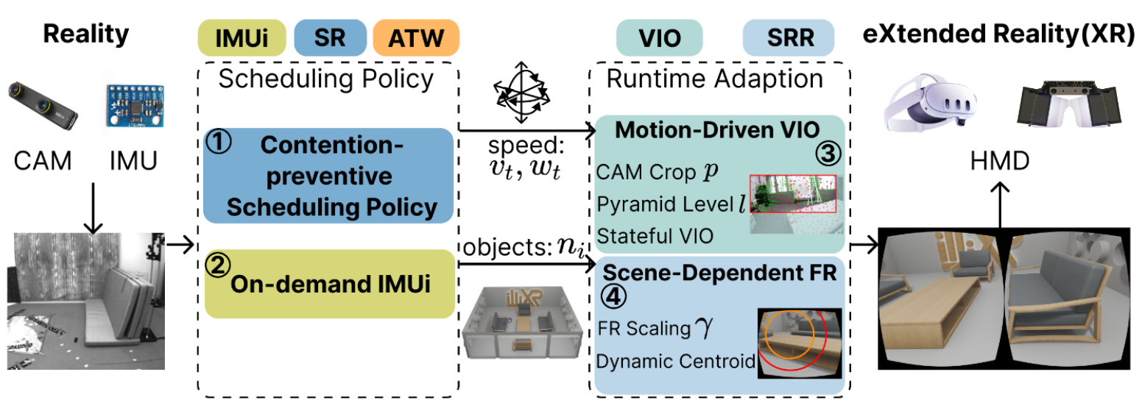
Our Solution: BOXR
BOXR: Body and Head Motion Optimization Framework for eXtended Reality
Introduces the C2D metric to capture the delay from body motions
Co-optimizes the delay from both body and head motions (M2D & C2D).
Addresses unique challenges in XR systems:
Resource contention, optimization tradeoffs, and varying execution time due to motion and scene dynamics

Slide 11
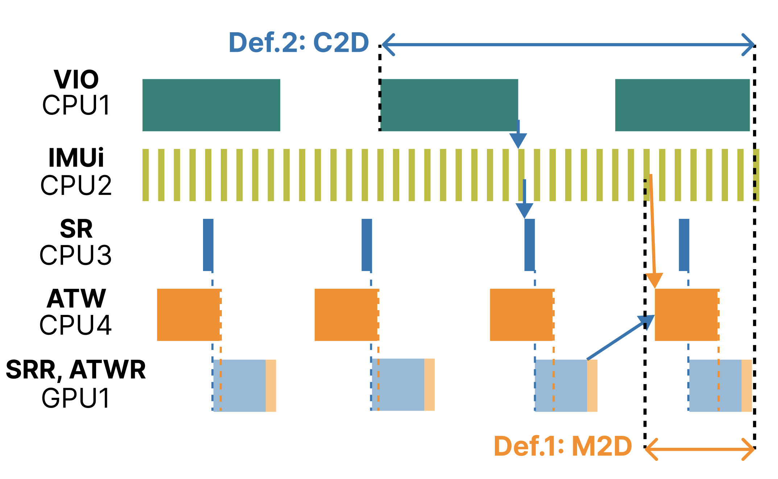
System bottleneck
Introduction
Background
Challenge
Methodology
Evaluation
XR adopts publisher-subscriber model
{
CPU tasks: VIO, IMUi, SR, ATW
VIO | Visual Inertial Odometer
IMUi | IMU Integration
SR | Scene Reconstruction
ATW | Asynchronous Timewarp

Slide 12
System bottleneck
Introduction
Background
Challenge
Methodology
Evaluation
XR adopts publisher-subscriber model
{
CPU tasks: VIO, IMUi, SR, ATW
GPU tasks: SRR, ATWR
Contention Between SRR and ATWR: Both tasks share the same stream and execute sequentially in a first-in-first-out order

Slide 13
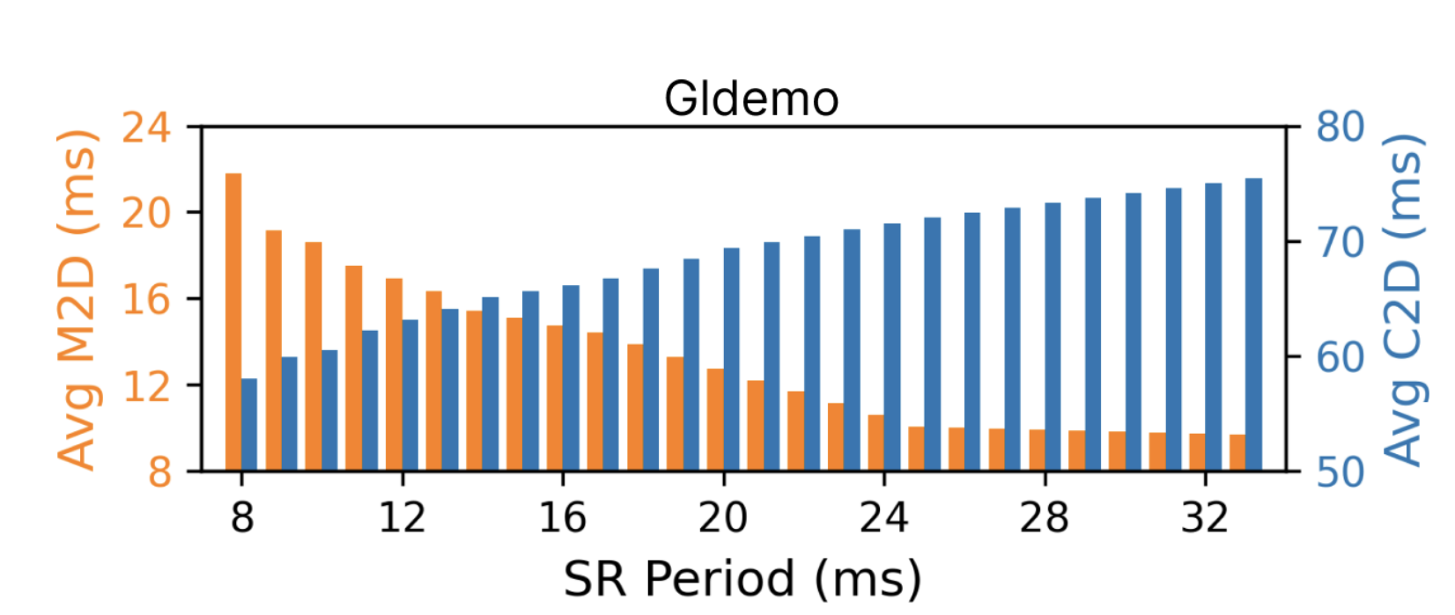
M2D and C2D Tradeoff
Introduction
Background
Challenge
Methodology
Evaluation
SR | Scene Reconstruction
ATW | Asynchronous Timewarp
Single Optimization of M2D: increase SR period to mitigate contention
However, C2D increases because less SR is executed: freshness of CAM data decreases
We need to consider both M2D and C2D during optimization

Slide 14
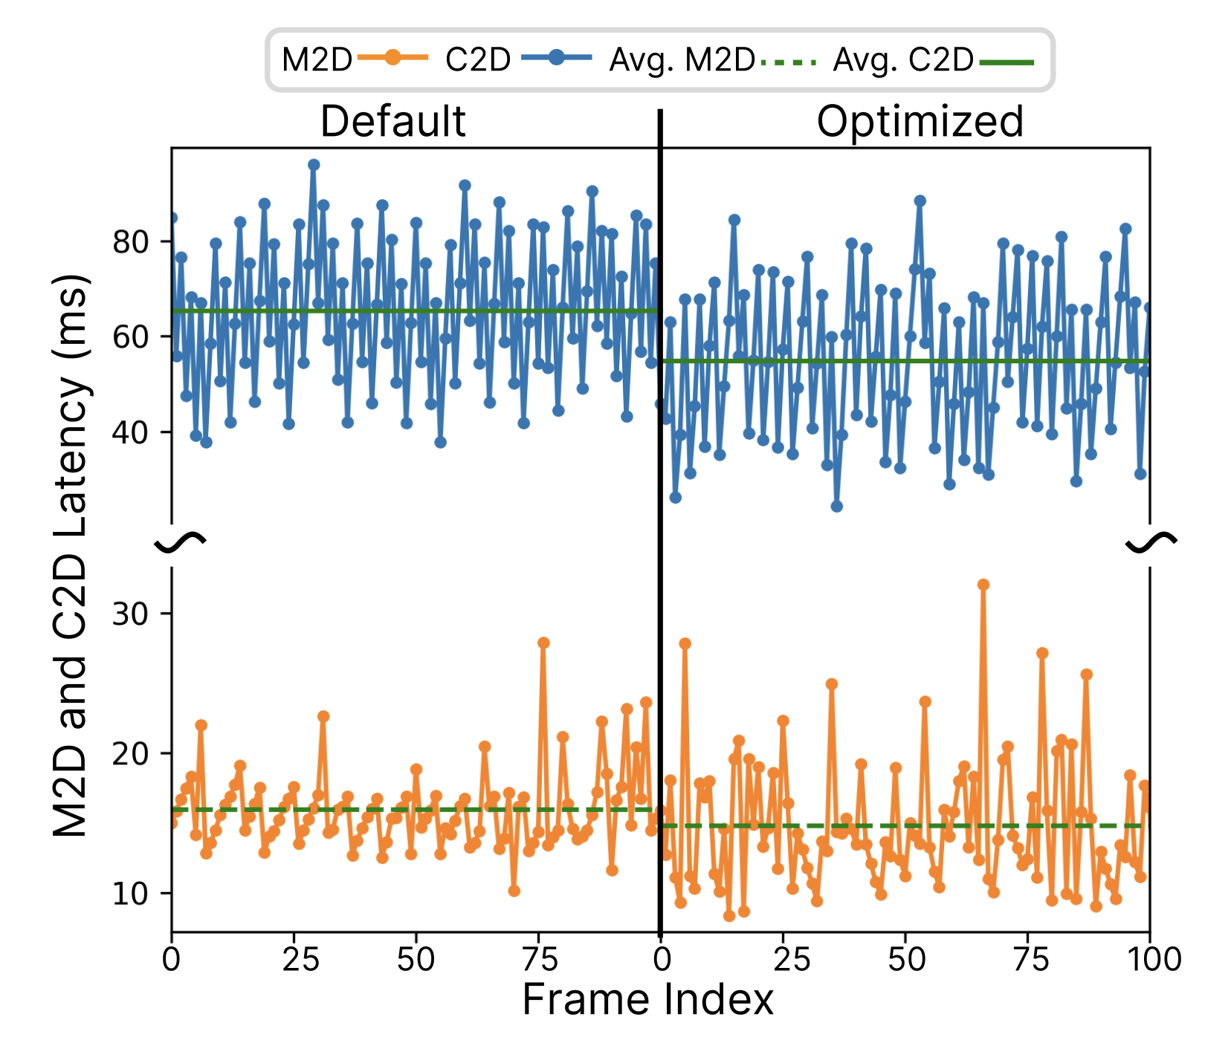
Simple Optimization of M2D and C2D does not work
Introduction
Background
Challenge
Methodology
Evaluation
Adjusting both SR and ATW period to minimize both average M2D and C2D
But M2D and C2D fluctuations increase!
Some Jobs have longer blocking time due to contention
Need to have scheduling policy that prevents contention!

Slide 15
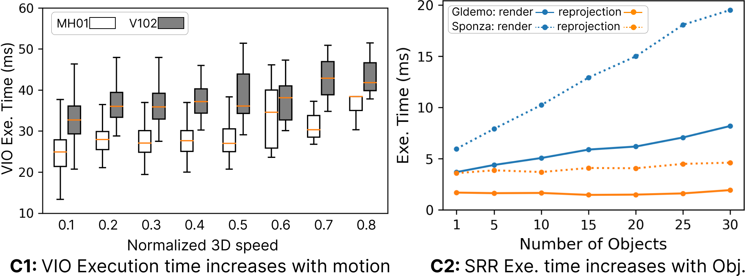
XR runtime characteristics
Introduction
Background
Challenge
Methodology
Evaluation
C1: Motion-dependent Tracking: Larger speed increases VIO exec. time
C2: Scene-dependent Rendering: More objects increase SRR exec. time (render)

Slide 16
BOXR Overview
Introduction
Background
Challenge
Methodology
Evaluation
Why design a scheduler and runtime adaption
Scheduling policy can be generated during setup to avoid large runtime overhead
Motion and scene objects can only be acquired during runtime
BOXR Scheduling policy
Contention-preventive scheduling: Prevents contention between SRR and ATWR while maintain the fresh raw pose information
On-demand IMUi: Executes IMUi only when fused pose is needed
BOXR Runtime Adaption
Motion-Driven VIO: Addresses C1: motion-dependent tracking
Scene-Dependent Foveated Rendering: Addresses C2: scene-dependent rendering

Slide 17
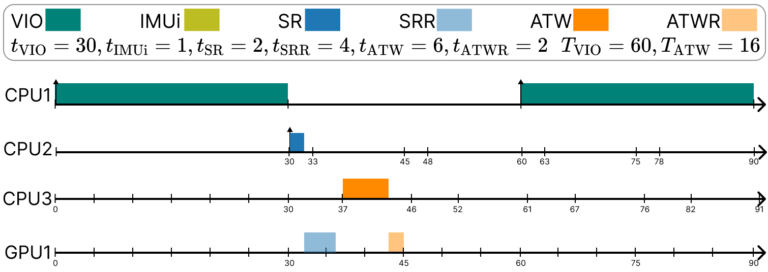
BOXR Scheduling policy: Contention-preventive
Introduction
Background
Challenge
Methodology
Evaluation
To avoid contention between ATWR and SRR, BOXR schedules ATW and ATWR jobs synchronously to SR and SRR jobs

Slide 18
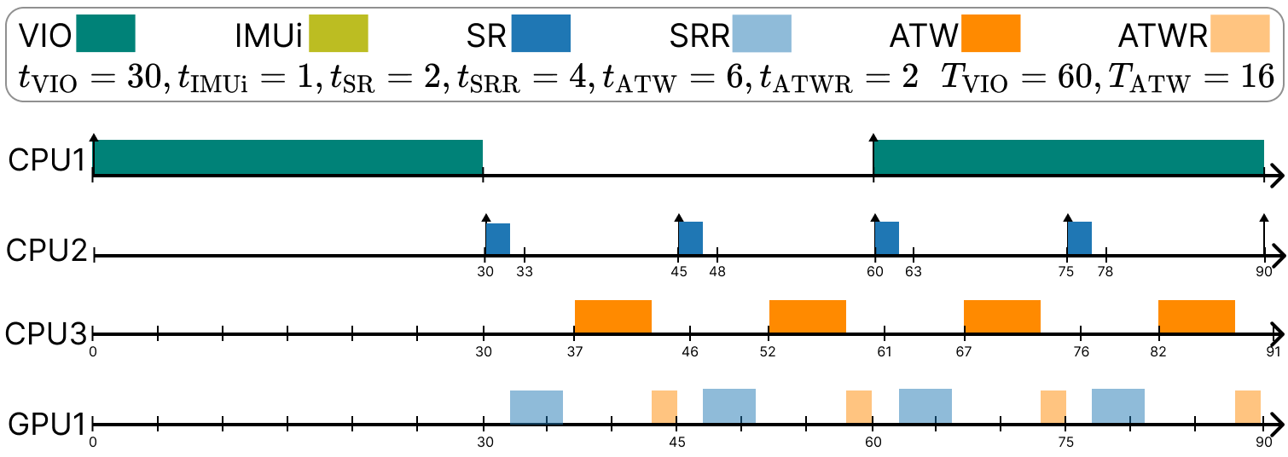
BOXR Scheduling policy: Contention-preventive
Introduction
Background
Challenge
Methodology
Evaluation
To maintain raw pose data freshness, BOXR determines the SR period that ensures each C2D sequence (VIO→IMUi→SR→SRR→ATW→ATWR) completes with no temporal overlap

Slide 19
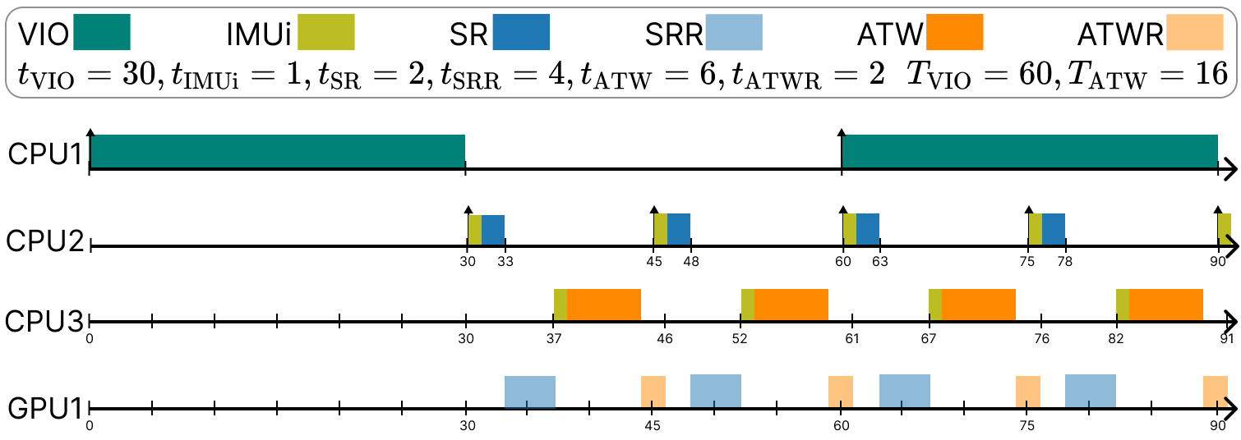
BOXR Scheduling policy: On-demand IMUi
Introduction
Background
Challenge
Methodology
Evaluation
To avoid wasted IMUi jobs, BOXR schedules IMUi to run only at the beginning of SR or ATW jobs

Slide 20
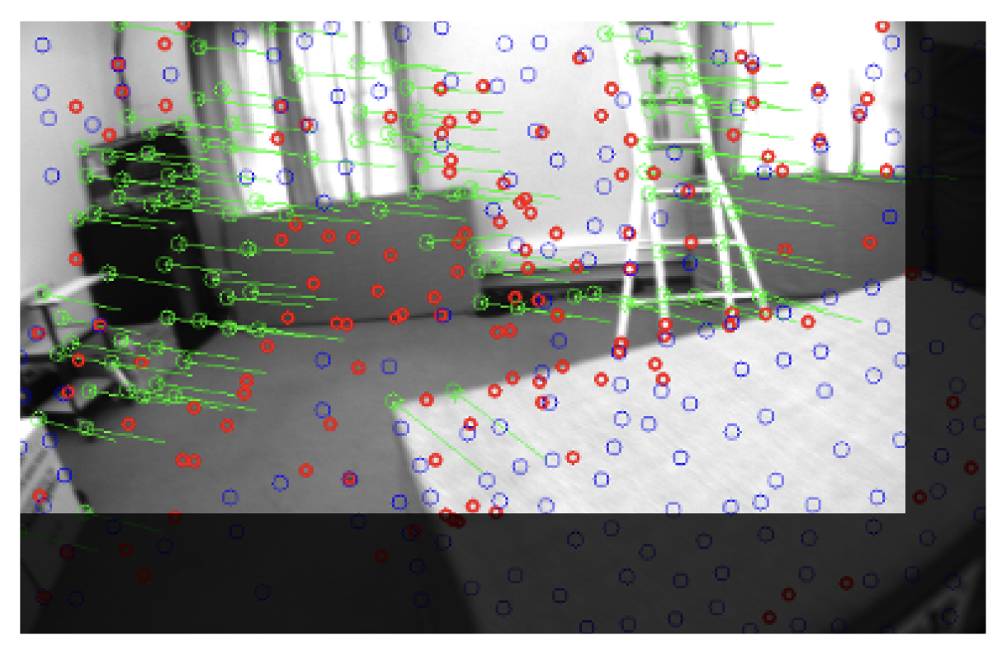
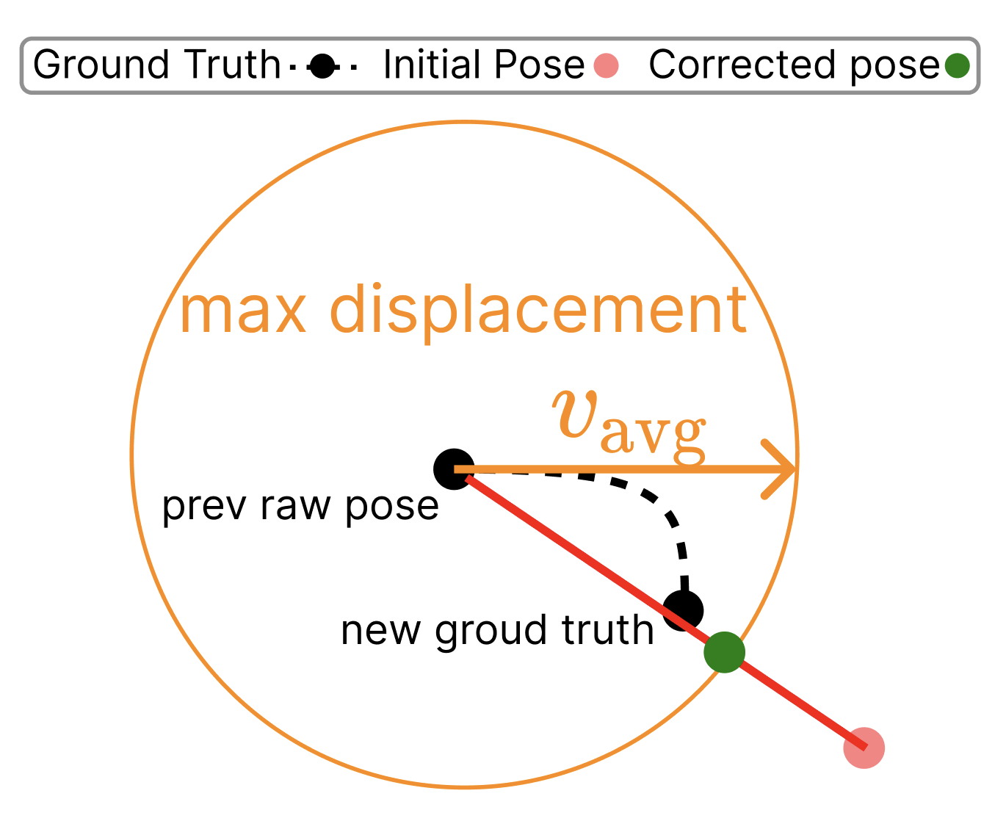
Runtime Adaption: Motion-Driven VIO
Introduction
Background
Challenge
Methodology
Evaluation
Goal: Manage the varying execution time of VIO while minimizing pose quality degradation
Image cropping: when motion is large, crop the image input
Level of pyramid adjustment: adjust the pyramid level in the VIO’s Multi-state Kalman Filter w.r.t motion
Error bounding: leverage the previous raw pose to calculate the maximum possible displacement. Bound the output pose within the displacement.

Slide 21
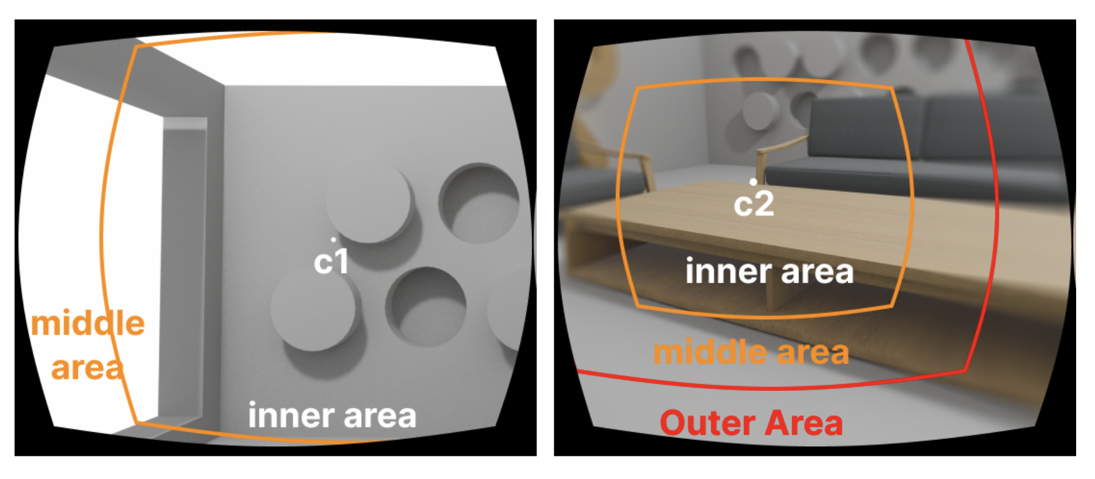
Runtime Adaption: Scene-Dependent Foveated Render
Introduction
Background
Challenge
Methodology
Evaluation
Goal: Control varying SRR execution time by scene-adaptive foveation
Dynamic foveation area: reduce the peripheral resolution when more objects are in the viewport
Dynamic Objects Centroid: fix the center of foveation to the objects’ centroid to effectively reduce render time

Slide 22
Evaluation and Baselines Setup
Introduction
Background
Challenge
Methodology
Evaluation
Setup:
Hardware Platform: PC, NVIDIA AGX Xavier, NVIDIA Orin Nano
XR applications: Table I
Trajectory: Table II
Baselines:
ILLIXR: Pub-Sub model
ILLIXR-OP: Optimized with SR and ATW periodicities changes
BOXR-S: Static BOXR only implements the BOXR scheduler
BOXR: Complete framework with both scheduler and runtime adaption

Slide 23
Efficiency: Low Runtime Overhead
Introduction
Background
Challenge
Methodology
Evaluation
BOXR runtime adaption only results up to 0.6% of system overhead

Slide 24
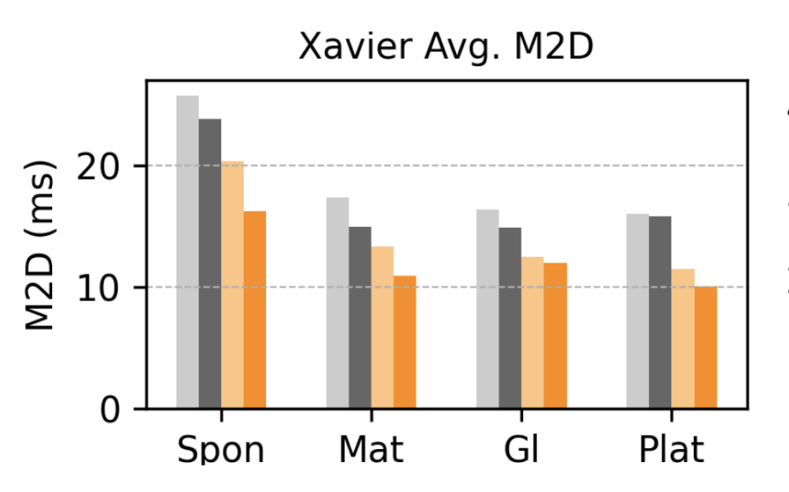
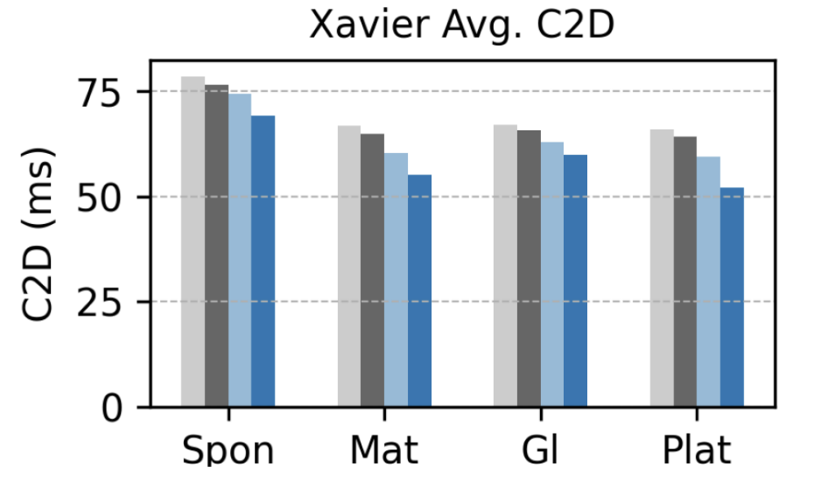
Effectiveness: M2D and C2D Reduction
Introduction
Background
Challenge
Methodology
Evaluation
BOXR General Effectiveness:
Xavier: on average 37% M2D and 27% C2D reduction
Real-world Gaming: BOXR reduces M2D and C2D miss rate by 69.2% and 34.1% respectively
DDL:
C2D
M2D

Slide 26
Conclusion
Discovers the C2D metric and co-optimize both M2D and C2D for both body and head motion
Addresses resource contention and increased execution time due to motion and objects
GitHub Link
Paper Link

